Slide 1

PAPERCLIP
AI AGENT COMPANY OS
COURSE SLIDES · WSQ
Manage AI Agents with Paperclip
WSQ Course Code: TGS-2023036646
TSC: Applications Integration · ICT-DIT-3003-1.1
Conducted by Tertiary Infotech Academy Pte Ltd · UEN 201200696W
Version v1.0 · 28 August 2026
© 2026 Tertiary Infotech Academy Pte Ltd. All rights reserved. · www.tertiarycourses.com.sg

Slide 2
COURSE ADMINISTRATION
Welcome & Housekeeping
Manage AI Agents with Paperclip (TGS-2023036646) · TGS-2023036646
© 2026 Tertiary Infotech Academy Pte Ltd
2

Slide 3
TRAQOM · SSG DIGITAL ATTENDANCE
Digital Attendance (Mandatory)
Three times a day
Take the AM, PM and Assessment digital attendance — mandatory for every WSQ-funded course.
Trainer shows the QR
The trainer or administrator displays the digital attendance QR code from the SSG portal.
1
2
Scan and submit
Scan the QR code with your mobile phone camera and submit your attendance.
75% minimum
A minimum of 75% attendance is required to be eligible for assessment and funding.
3
4
Manage AI Agents with Paperclip (TGS-2023036646) · TGS-2023036646
© 2026 Tertiary Infotech Academy Pte Ltd
3

Slide 4
YOUR TRAINER · GENERAL
About the Trainer
NAME
____________________________________________
?
TITLE / DESIGNATION
____________________________________________
QUALIFICATIONS
____________________________________________
Your Trainer
AREAS OF EXPERTISE
____________________________________________
General Trainer template —
to be completed by the trainer
TRAINING & INDUSTRY EXPERIENCE
____________________________________________
CONTACT
____________________________________________
Manage AI Agents with Paperclip (TGS-2023036646) · TGS-2023036646
© 2026 Tertiary Infotech Academy Pte Ltd
4

Slide 5
YOUR TRAINER
About the Trainer
ROLE
Principal Trainer, Tertiary Infotech Academy Pte Ltd
AA
EXPERTISE
Generative AI, large language models, agentic AI systems and applied machine learning.
Dr. Alfred Ang
DELIVERS
WSQ courses on AI, agentic AI, LLM application development, prompt engineering and data science.
Principal Trainer
Tertiary Infotech Academy Pte Ltd
FOUNDER
Founder and lead instructor at Tertiary Infotech / Tertiary Courses.
Manage AI Agents with Paperclip (TGS-2023036646) · TGS-2023036646
© 2026 Tertiary Infotech Academy Pte Ltd
5

Slide 6
ICE-BREAKER
Let's Know Each Other
Who you are
Your name, your organisation and the role you play in it.
What you've used
Your experience with AI agents, automation or command-line tools — if any. No experience needed.
1
2
What you'd delegate
One task in your work you would hand to a team of AI agents.
What you wouldn't
One task you would NOT delegate — and the reason why. We come back to this in Topic 1.
3
4
Manage AI Agents with Paperclip (TGS-2023036646) · TGS-2023036646
© 2026 Tertiary Infotech Academy Pte Ltd
6

Slide 7
HOUSEKEEPING
Ground Rules
Set your mobile phone to silent mode.
Participate actively — no question is too small.
1
2
Mutual respect: agree to disagree.
One conversation at a time.
3
4
Be punctual; return from breaks on time.
75% attendance is required.
5
6
Manage AI Agents with Paperclip (TGS-2023036646) · TGS-2023036646
© 2026 Tertiary Infotech Academy Pte Ltd
7

Slide 8
LMS / TMS · lms-tms.tertiaryinfotech.com
Download Your Course Material
Go to the LMS portal
Open https://lms-tms.tertiaryinfotech.com in your browser.
Log in
Sign in with the account e-mail you used to register for this course.
1
2
Open this course
Select 'Manage AI Agents with Paperclip'.
Download
Download the Trainer Slides, Learner Guide and Lesson Plan (PDF).
3
4
Get the labs
Clone the lab repository from GitHub — the link is on the course page.
Keep them open
You may use these materials during the open-book assessment.
5
6
Manage AI Agents with Paperclip (TGS-2023036646) · TGS-2023036646
© 2026 Tertiary Infotech Academy Pte Ltd
8

Slide 9
SKILLS FRAMEWORK · TSC
Skills Framework Alignment
TSC Title
Applications Integration
TSC Code
ICT-DIT-3003-1.1
1
2
Training hours
14 hours across 2 days
Assessment hours
2 hours — Written Assessment + Practical Performance
3
4
Level
Beginner to Intermediate
Mode
Physical, instructor-led with hands-on labs
5
6
Manage AI Agents with Paperclip (TGS-2023036646) · TGS-2023036646
© 2026 Tertiary Infotech Academy Pte Ltd
9

Slide 10
SCHEDULE
Lesson Plan — 2 Days, 8 hours/day
Day 1
Day 2
• Day 1 — Agentic AI foundations, the Paperclip control plane, and building your first goal-aligned AI agent company
– Digital Attendance (AM) · Introductions · Learning Outcomes
– Topic 1: Fundamentals of Agentic AI and Paperclip (Lab 1)
– Lunch Break · Digital Attendance (PM)
– Topic 2: Building AI Agents with Paperclip (Labs 2–3)
– Day 1 recap
• Day 2 — Multi-agent operations: decomposition, hand-offs, routines, budgets, approvals and the closed audit loop
– Digital Attendance (AM) · Day 1 recap
– Topic 3: Developing Intelligent Multi-Agent Systems (Labs 4–5)
– Lunch Break · Digital Attendance (PM)
– Topic 4: Deploying and Managing AI Agents (Lab 6)
– TRAQOM Survey · Digital Attendance (Assessment)
– Final Assessment (WA + PP) — 2 hours
Manage AI Agents with Paperclip (TGS-2023036646) · TGS-2023036646
© 2026 Tertiary Infotech Academy Pte Ltd
10

Slide 11
WHAT YOU'LL ACHIEVE
Learning Outcomes
LO1 · Identify & scan feasibility
Explain the Paperclip control-plane model and judge when a managed multi-agent company earns its coordination cost.
LO2 · Integrate & develop
Install Paperclip, create a goal-aligned company, build the reporting tree and connect agent runtimes, skills and workspaces safely.
1
2
LO3 · Test & verify
Decompose a mission into issues, run bounded heartbeats and verify hand-offs through runs, comments, artifacts and the activity log.
LO4 · Resolve & modify
Diagnose adapter, budget and routine failures, and modify governance, approvals and cost boundaries to keep the operation safe.
3
4
Manage AI Agents with Paperclip (TGS-2023036646) · TGS-2023036646
© 2026 Tertiary Infotech Academy Pte Ltd
11

Slide 12
FOUR TOPICS · 6 HANDS-ON LABS
Course Outline
1
Topic 01 — Fundamentals of Agentic AI and Paperclip
Agentic AI foundations · the control-plane model · the twelve subsystems · feasibility and when NOT to use multi-agent
2
Topic 02 — Building AI Agents with Paperclip
Install and verify · company and mission · the CEO · org chart · runtime adapters · workspaces, instructions and secrets
3
Topic 03 — Developing Intelligent Multi-Agent Systems
Projects, goals and lineage · issue decomposition · assignment and hand-off · sequential specialists · verifying between disparate components
4
Topic 04 — Deploying and Managing AI Agents
Routines and schedules · layered budgets · approvals and audit · operator intervention · deployment, portability and troubleshooting
Manage AI Agents with Paperclip (TGS-2023036646) · TGS-2023036646
© 2026 Tertiary Infotech Academy Pte Ltd
12

Slide 13
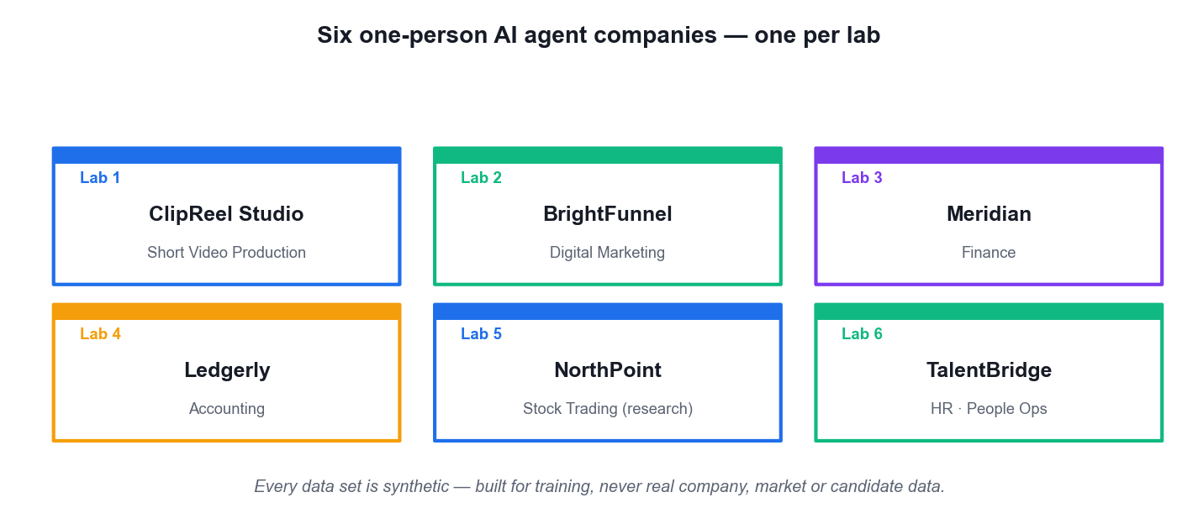
THE COURSE SIMULATION
Six One-Person AI Agent Companies
Each lab builds a different one-person company — so you see the same control model applied to six very different businesses.
Manage AI Agents with Paperclip (TGS-2023036646) · TGS-2023036646
© 2026 Tertiary Infotech Academy Pte Ltd
13

Slide 14
BEFORE YOU START
Briefing for Assessment
Do · Clear your desk
Place phones and other materials under the table or on the floor.
Don't · No recording
No photos or recording of assessment scripts.
1
2
Don't · No discussion
Work individually — no discussion during the assessment.
Do · Black or blue pen
Use a black or blue pen for hard-copy assessments.
3
4
Don't · No correction fluid
No liquid paper or correction tape may be used.
Do · Stop on time
Scripts are collected when time is up.
5
6
Manage AI Agents with Paperclip (TGS-2023036646) · TGS-2023036646
© 2026 Tertiary Infotech Academy Pte Ltd
14

Slide 15
FINAL ASSESSMENT
Assessment
Written Assessment (WA)
Short-Answer Questions (SAQ) · 5 questions · 1 hour · open book. Tests the underpinning knowledge (K1–K5).
Practical Performance (PP)
4 hands-on Paperclip tasks · 1 hour · open book. Tests the ability you built in the labs (A1–A4).
1
2
Open book
You may use the course slides, the Learner Guide and approved materials only.
Eligibility
A minimum of 75% attendance is required to be eligible for assessment and funding.
3
4
Result
You are assessed as Competent (C) or Not Yet Competent (NYC) on each instrument.
Appeals
An appeal process is available if you wish to contest an assessment outcome.
5
6
Manage AI Agents with Paperclip (TGS-2023036646) · TGS-2023036646
© 2026 Tertiary Infotech Academy Pte Ltd
15

Slide 16
ON ASSESSMENT DAY
Assessment Flow
1
2
3
4
5
TRAQOM survey
Digital attendance
Sit WA then PP
Submit on the LMS
Sign the record
Scan the QR code on the LMS
Scan the SSG assessment QR
Open book · 1 hour each
Upload your completed answers
Sign the Assessment Summary Record
REMEMBER
All five steps are mandatory for WSQ funding — missing the digital attendance or the TRAQOM survey can invalidate your claim.
Manage AI Agents with Paperclip (TGS-2023036646) · TGS-2023036646
© 2026 Tertiary Infotech Academy Pte Ltd
16

Slide 17
EXAMS.TERTIARYINFOTECH.COM
Practice Exam
Practise before the real thing
Try the practice questions at https://exams.tertiaryinfotech.com before the final assessment.
Same format
Short-answer knowledge questions in the same style as the Written Assessment.
1
2
Self-marked
Use it to find the topics you need to revisit, not to score yourself.
Free and unlimited
Attempt it as many times as you like during the course.
3
4
Manage AI Agents with Paperclip (TGS-2023036646) · TGS-2023036646
© 2026 Tertiary Infotech Academy Pte Ltd
17

Slide 18
WSQ FUNDING
Criteria for Funding
Attendance
A minimum attendance rate of 75%, based on the SSG Digital Attendance record.
Assessment
Complete both assessment components and be assessed as 'Competent'.
1
2
Digital attendance
Scan the SSG QR code for AM, PM and Assessment on every training day.
TRAQOM survey
Complete the mandatory TRAQOM course feedback survey on the LMS.
3
4
Manage AI Agents with Paperclip (TGS-2023036646) · TGS-2023036646
© 2026 Tertiary Infotech Academy Pte Ltd
18

Slide 19
LAB ENVIRONMENT
Set Up Before We Start
Node.js 20 or later
Paperclip requires Node 20+. Check with node --version.
A normal user shell
Never run onboarding from an elevated Administrator or root shell.
1
2
An agent runtime
One trainer-approved CLI runtime (e.g. Claude Code, Codex, Gemini CLI).
Git
Used to baseline each agent workspace so every change is a readable diff.
3
4
Lab repository
Clone the course labs — the link is on your LMS course page.
Synthetic data only
All six company data sets are fabricated for training. Never load real company, market or candidate data.
5
6
Manage AI Agents with Paperclip (TGS-2023036646) · TGS-2023036646
© 2026 Tertiary Infotech Academy Pte Ltd
19

Slide 20
CORE CONCEPTS
From a Single Agent to a Managed Agent Company
Manage AI Agents with Paperclip (TGS-2023036646) · TGS-2023036646
© 2026 Tertiary Infotech Academy Pte Ltd
20

Slide 21
THE SIX INGREDIENTS
What Makes a System 'Agentic'?
Reasoning
The model plans a sequence of steps instead of answering in one shot.
Tool use
It calls functions, CLIs and APIs to fetch live data or take real actions.
1
2
Memory
State carries context across turns — and, in Paperclip, across heartbeats.
Autonomy
It decides which tool to use and when the work is actually finished.
3
4
Collaboration
Several specialised agents divide the work and hand off between themselves.
Guardrails
Policies, budgets and approvals constrain what the agent may do.
5
6
Manage AI Agents with Paperclip (TGS-2023036646) · TGS-2023036646
© 2026 Tertiary Infotech Academy Pte Ltd
21

Slide 22
WHY A CONTROL PLANE
An LLM answers. An agent acts. A company coordinates.
Paperclip is the third layer — it does not make your agents smarter, it makes a team of them accountable.
Manage AI Agents with Paperclip (TGS-2023036646) · TGS-2023036646
© 2026 Tertiary Infotech Academy Pte Ltd
22

Slide 23
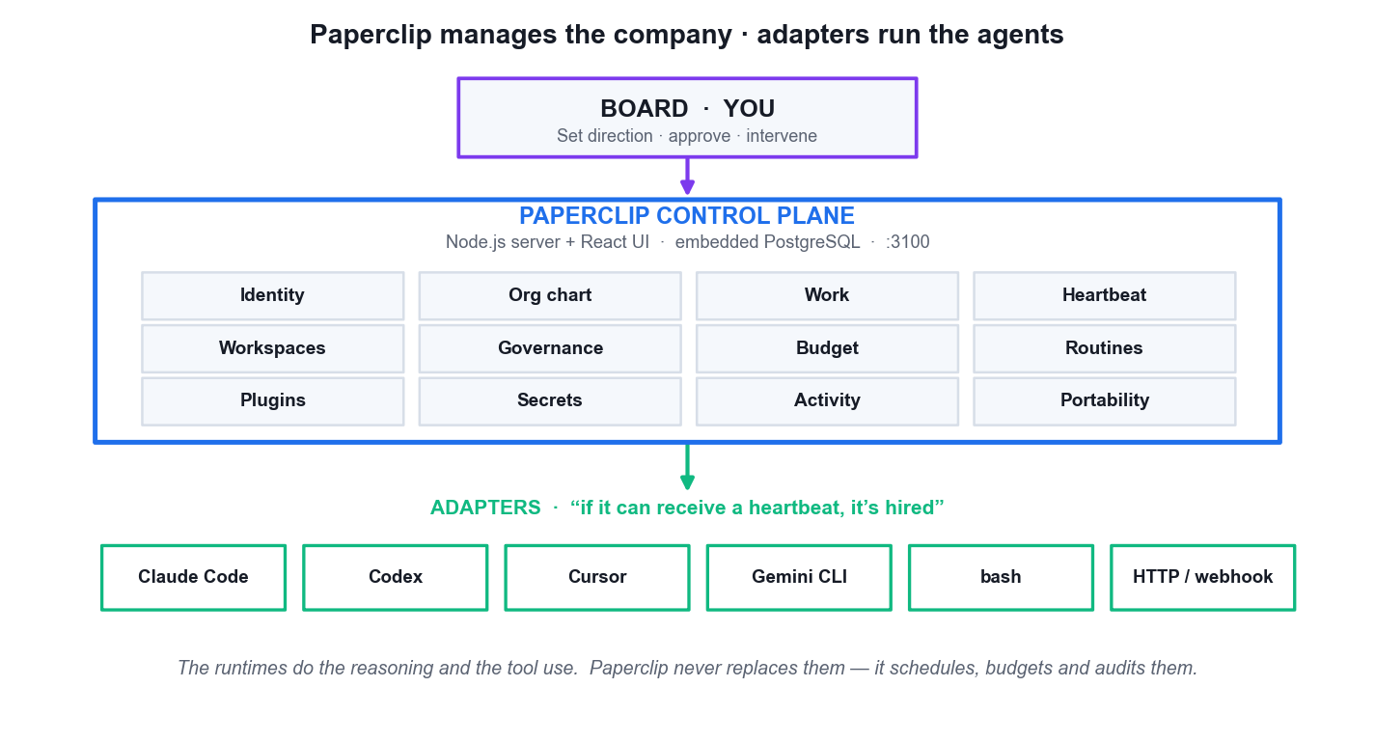
LO1 · ORCHESTRATE, DO NOT REPLACE, THE RUNTIME
Paperclip Control-Plane Architecture
Board · you
You set direction, approve governed actions and intervene. Authority never leaves the human.
The control plane
Stores companies, org charts, issues, budgets, secrets and the audit trail. Node.js + React on port 3100.
The adapters
Claude Code, Codex, Cursor, Gemini CLI, bash or an HTTP bot — these do the actual reasoning.
The separation
Organisational authority, runtime capability and verification evidence are kept deliberately apart.
Manage AI Agents with Paperclip (TGS-2023036646) · TGS-2023036646
© 2026 Tertiary Infotech Academy Pte Ltd
23

Slide 24
LO1 · SCOPE THE TOOL CORRECTLY
What Paperclip Is — and Is Not
IS · an organisational control plane
Org charts, issues, budgets, approvals and a durable audit trail for a team of agents.
IS · a runtime-agnostic scheduler
'If it can receive a heartbeat, it's hired.' It schedules and budgets agents without replacing them.
1
2
IS NOT · an agent framework
It does not dictate how your agent reasons, prompts or calls tools. That is the adapter's job.
IS NOT · a chatbot or workflow builder
No drag-and-drop canvas, no prompt manager, and not designed for a single-agent use case.
3
4
Choosing Paperclip is an organisational decision, not a modelling decision.
Manage AI Agents with Paperclip (TGS-2023036646) · TGS-2023036646
© 2026 Tertiary Infotech Academy Pte Ltd
24

Slide 25
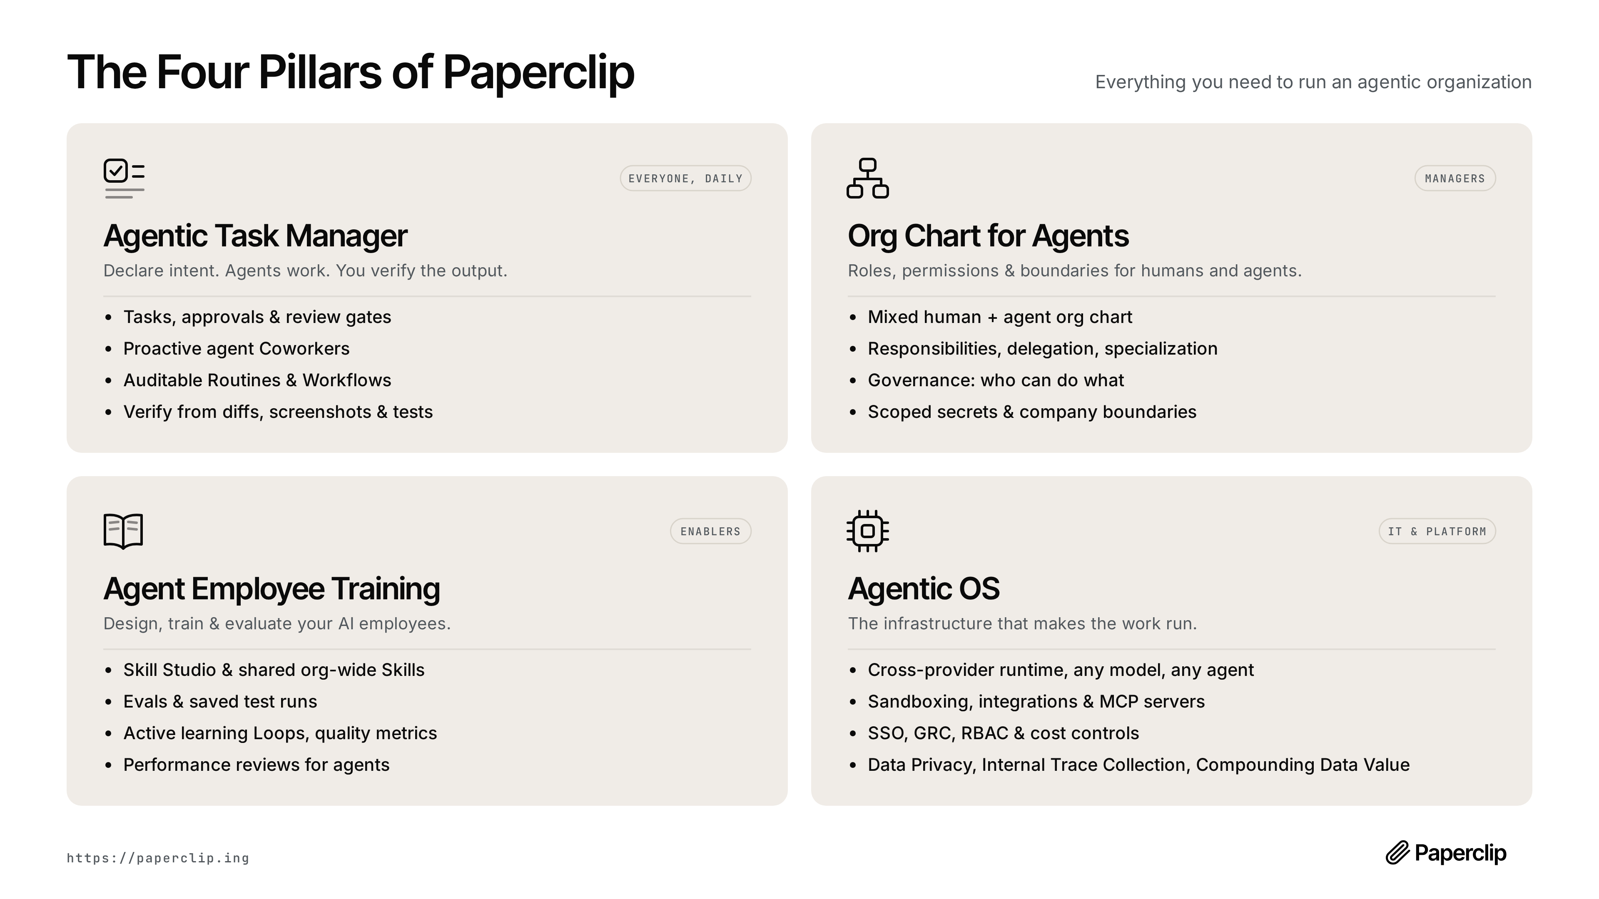
LO1 · THE PRODUCT MODEL
The Four Pillars of Paperclip
Agentic task manager · org chart for agents · agent employee training · agentic OS. Source: the official Paperclip project.
Manage AI Agents with Paperclip (TGS-2023036646) · TGS-2023036646
© 2026 Tertiary Infotech Academy Pte Ltd
25

Slide 26
LO1 · WHAT THE PLATFORM ACTUALLY CONTAINS
The Twelve Subsystems
Identity & org chart
Who exists, who reports to whom, and what each role may do.
Work & heartbeat
Issues with atomic checkout, woken by bounded execution bursts.
1
2
Workspaces & runtime
Isolated roots (git worktrees) and the adapter that runs there.
Governance & budget
Approval gates and caps enforced at checkout, not at billing.
3
4
Routines & plugins
Scheduled recurring work, and the skills library agents draw on.
Secrets, activity & portability
Scoped injection, a durable audit log, and export/import of a whole company.
5
6
Manage AI Agents with Paperclip (TGS-2023036646) · TGS-2023036646
© 2026 Tertiary Infotech Academy Pte Ltd
26

Slide 27
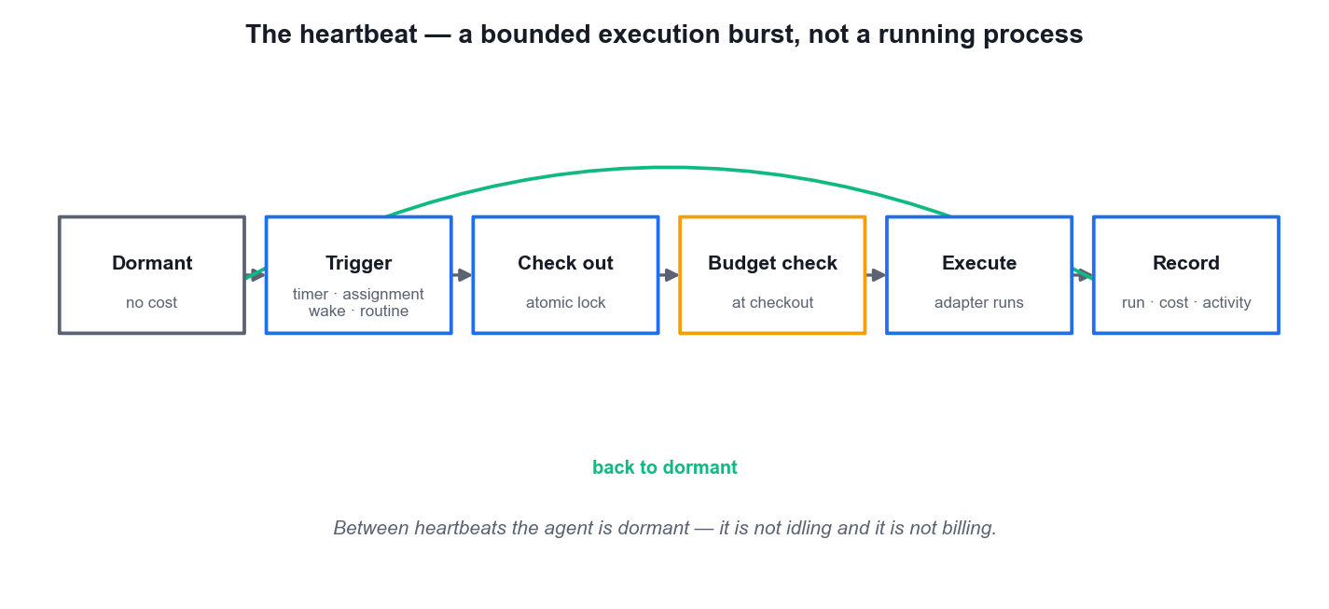
LO1 · THE EXECUTION MODEL
The Heartbeat — Bounded Execution, Not a Running Process
Dormant by default
Between heartbeats the agent is not idling and not billing.
Four triggers
A timer, an assignment, an on-demand wake, or a routine.
Atomic checkout
An execution lock means two heartbeats can never double-work the same issue.
Budget checked first
The cap is tested at checkout — a runaway loop stops at the ceiling.
Manage AI Agents with Paperclip (TGS-2023036646) · TGS-2023036646
© 2026 Tertiary Infotech Academy Pte Ltd
27

Slide 28
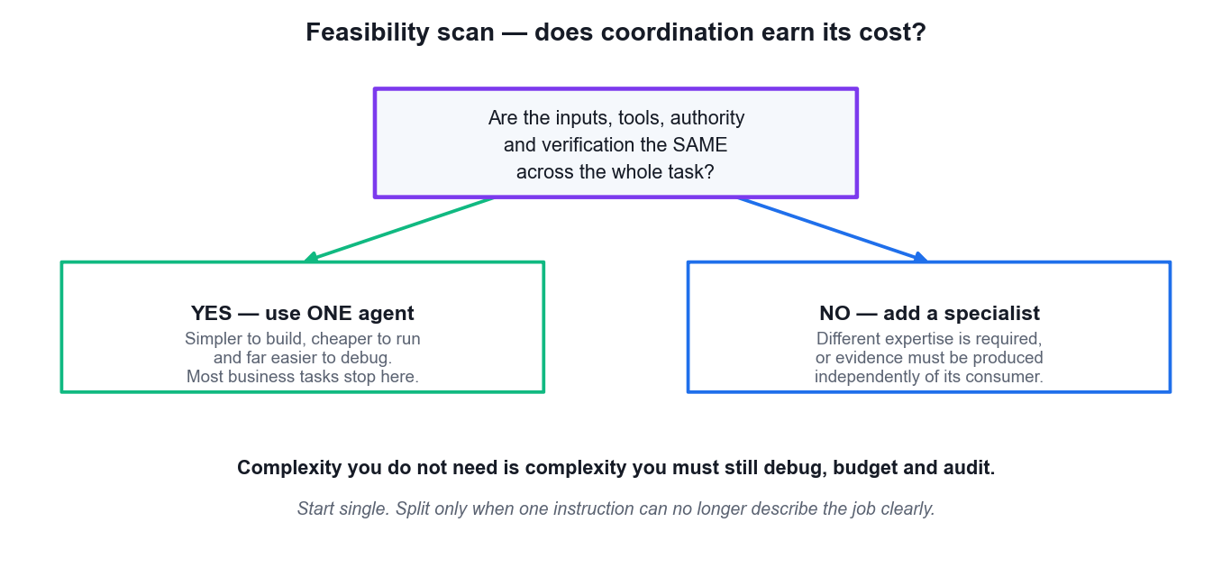
LO1 · THE MOST IMPORTANT DECISION IN THE COURSE
Feasibility Scan — Does Coordination Earn Its Cost?
Use ONE agent
When inputs, tools, authority and verification are the same across the whole task.
Add a specialist
Only when different expertise is required, or evidence must be produced independently.
The real cost
Every extra agent is another workspace, budget, instruction and audit trail to maintain.
Start single
Split only when one instruction can no longer describe the job clearly.
Manage AI Agents with Paperclip (TGS-2023036646) · TGS-2023036646
© 2026 Tertiary Infotech Academy Pte Ltd
28

Slide 29
LO1 · WHEN THE CONTROL PLANE PAYS FOR ITSELF
One Agent vs a Paperclip Agent Company
Dimension
One agent, run by hand
A Paperclip agent company
Direction
Restated in every prompt
A mission that flows down as goal lineage
Memory
Ends with the session
Persists across heartbeats in the control plane
Cost
Discovered on the invoice
Capped at checkout per company, project and agent
Authority
Implicit — whatever you allow
Explicit — org chart, roles and approvals
Evidence
Scrollback you must trust
Runs, comments, diffs and a durable activity log
Main risk
Context saturation
Coordination overhead you did not need
WHEN IT MATTERS The right answer is often still ONE agent. Reach for the company when the work has genuinely separable roles that must each be evidenced.
Manage AI Agents with Paperclip (TGS-2023036646) · TGS-2023036646
© 2026 Tertiary Infotech Academy Pte Ltd
29

Slide 30
LESSON PLAN · TIME ALLOCATION
Where Course Time Goes — Topic Weighting
WHAT THE DATA SHOWS
The four topics carry equal weighting — but Topics 3 and 4 are where the assessable practical skill sits, because that is where governance and verification are actually exercised.
Manage AI Agents with Paperclip (TGS-2023036646) · TGS-2023036646
© 2026 Tertiary Infotech Academy Pte Ltd
30

Slide 31
01
TOPIC 01
Fundamentals of Agentic AI and Paperclip
Agentic AI foundations · the control-plane model · the twelve subsystems · feasibility and when NOT to use multi-agent
Manage AI Agents with Paperclip (TGS-2023036646) · TGS-2023036646
© 2026 Tertiary Infotech Academy Pte Ltd
31

Slide 32
TOPIC WEIGHTING 25%
Key Concepts — Fundamentals of Agentic AI and Paperclip
Agentic AI adds reasoning, tool use, memory and autonomy on top of a language model, so the system completes work rather than only producing text.
Paperclip is an organisational control plane — a Node.js server with a React UI that coordinates agents, goals, work, cost and governance. It is not an agent framework and it does not perform the reasoning itself.
1
2
The defining separation: Paperclip manages the company; adapters run the agents. Organisational authority, runtime capability and verification evidence stay apart.
A company is the boundary for one mission, its human members, AI employees, projects, issues, budget and activity history. One deployment holds many companies.
3
4
Manage AI Agents with Paperclip (TGS-2023036646) · TGS-2023036646
© 2026 Tertiary Infotech Academy Pte Ltd
32

Slide 33
TOPIC WEIGHTING 25%
Key Concepts — Fundamentals of Agentic AI and Paperclip (continued)
The four pillars are the agentic task manager, the org chart for agents, agent employee training (skills and evaluations) and the agentic OS (runtime, sandboxing, MCP, RBAC and cost control).
Twelve subsystems make up the platform: identity, org chart, work, heartbeat, workspaces, governance, budget, routines, plugins, secrets, activity and portability.
1
2
A heartbeat is a bounded execution burst triggered by a timer, an assignment, an on-demand wake or a routine. Between heartbeats the agent is dormant, not idling.
Work is checked out atomically with an execution lock, so two heartbeats can never double-work the same issue or race past a budget ceiling.
3
4
Manage AI Agents with Paperclip (TGS-2023036646) · TGS-2023036646
© 2026 Tertiary Infotech Academy Pte Ltd
33

Slide 34
TOPIC WEIGHTING 25%
Key Concepts — Fundamentals of Agentic AI and Paperclip (continued)
'If it can receive a heartbeat, it's hired' — adapters exist for Claude Code, Codex, Cursor, Gemini CLI, bash processes and HTTP/webhook bots.
Feasibility comes before architecture: use one agent when the inputs, tools, authority and verification are the same across the whole task.
1
2
Add a specialist only when different expertise is genuinely required, or when evidence must be produced independently of the agent that will use it.
Installation is ready only when Node.js, the Paperclip configuration, the embedded database, server health, the browser UI and the doctor diagnostic all agree.
3
4
Manage AI Agents with Paperclip (TGS-2023036646) · TGS-2023036646
© 2026 Tertiary Infotech Academy Pte Ltd
34

Slide 35
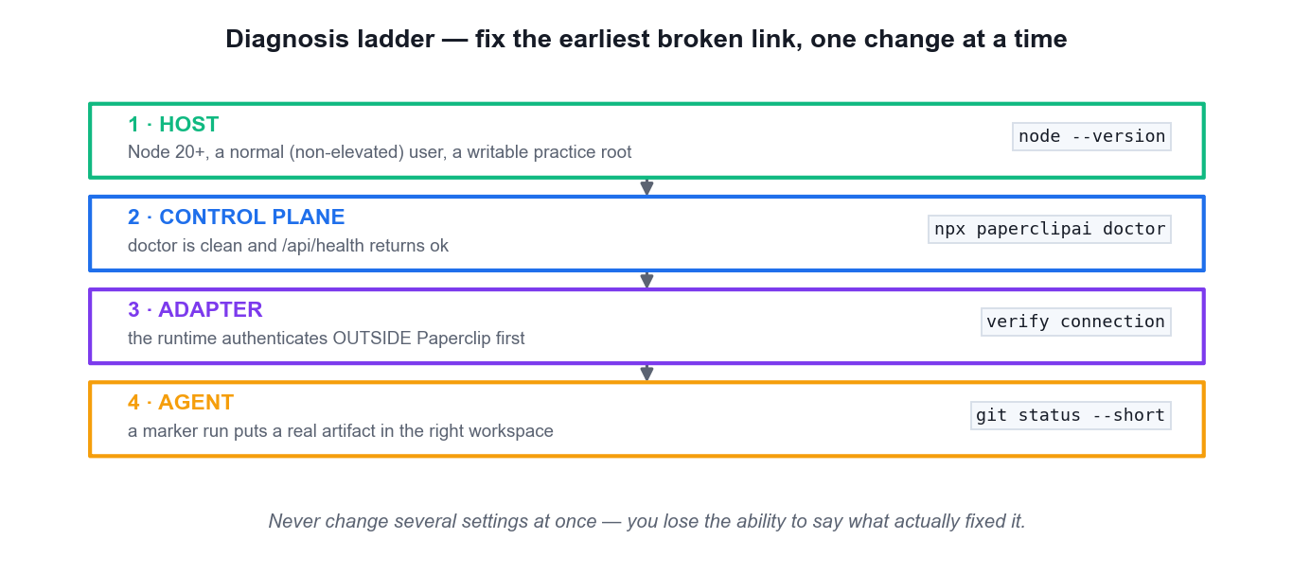
LO4 · TROUBLESHOOTING DISCIPLINE
Diagnosis Ladder — Fix the Earliest Broken Link
Host first
Node 20+, a normal non-elevated user, a writable practice root.
Then the control plane
doctor is clean and /api/health returns ok.
Then the adapter
The runtime must authenticate OUTSIDE Paperclip first.
Then the agent
A marker run puts a real artifact in the right workspace.
Manage AI Agents with Paperclip (TGS-2023036646) · TGS-2023036646
© 2026 Tertiary Infotech Academy Pte Ltd
35

Slide 36
LO2 · THE READINESS CHECKLIST
Installation Is Ready Only When Everything Agrees
Node.js
Major version 20 or later — the most common cause of a failed onboard.
Configuration & database
Written by onboard; the embedded PostgreSQL starts as the normal user.
1
2
Server health
GET /api/health returns an ok status.
Browser UI
http://localhost:3100 loads without a connection error.
3
4
Doctor
npx paperclipai doctor completes with no blocking error.
Evidence
All of the above recorded — with no credential ever captured.
5
6
A green badge is not evidence. An observable artifact is.
Manage AI Agents with Paperclip (TGS-2023036646) · TGS-2023036646
© 2026 Tertiary Infotech Academy Pte Ltd
36

Slide 37
WHAT YOU'LL DO
Hands-On Labs — Fundamentals of Agentic AI and Paperclip
Lab 1
—
—
• Install Paperclip and Prove the Control Plane (ClipReel Studio)
• ClipReel Studio (Short Video Production)
• —
• —
Manage AI Agents with Paperclip (TGS-2023036646) · TGS-2023036646
© 2026 Tertiary Infotech Academy Pte Ltd
37

Slide 38
LAB 1 · HANDS-ON
Install Paperclip and Prove the Control Plane (ClipReel Studio)
SIMULATED COMPANY · ClipReel Studio (Short Video Production)
You prepare a dedicated synthetic practice root for ClipReel Studio, a one-person short-video production company, verify the supported Node.js runtime, onboard Paperclip as a normal (non-elevated) user, and then inspect BOTH the built-in diagnostic and the live health endpoint. Proving the control plane before you hire any agent matters because every later adapter, budget or heartbeat failure is far easier to isolate when the platform itself has a recorded clean baseline.
YOU'LL BUILD
MAPS TO
A running Paperclip instance at http://localhost:3100 plus evidence/lab01-installation.md recording the Node/npm versions, the doctor summary and the /api/health response — with no credentials captured.
LO1: Explain the control-plane / runtime boundary and verify a healthy local Paperclip installation with observable evidence.
Tools: Node.js 20+, npm/npx, Paperclip CLI, browser, terminal or PowerShell
Full step-by-step procedure: Learner Guide, Lab 1 · labs/ folder
Manage AI Agents with Paperclip (TGS-2023036646) · TGS-2023036646
© 2026 Tertiary Infotech Academy Pte Ltd
38

Slide 39
LAB 1 · PROCESS MAP
How Lab 1 Runs
1
2
3
4
5
Prepare the practice root
Verify Node.js 20+
Onboard Paperclip
Run doctor
Prove /api/health
separate workspace + evidence folders
the top cause of a failed onboard
normal user shell — never sudo
fix the EARLIEST error first
record the clean baseline
THE POINT
LO1: Explain the control-plane / runtime boundary and verify a healthy local Paperclip installation with observable evidence.
Manage AI Agents with Paperclip (TGS-2023036646) · TGS-2023036646
© 2026 Tertiary Infotech Academy Pte Ltd
39

Slide 40
LAB 1 · VERIFY
Install Paperclip and Prove the Control Plane (ClipReel Studio)
✅ Expected result
npx paperclipai doctor completes with no unresolved blocking error, GET http://localhost:3100/api/health returns status ok, the browser loads the Paperclip UI, and evidence/lab01-installation.md records all three checks with no credential or personal identifier.
IF IT DOESN'T WORK
Embedded PostgreSQL refuses to start
The browser cannot reach port 3100
npx resolves against a private registry
Confirm the shell is NOT elevated. Stop the process and re-run onboarding as the normal user who owns the practice folder.
Run npx paperclipai doctor, then npx paperclipai run, and query /api/health again BEFORE touching any firewall setting.
Retry with npx --registry https://registry.npmjs.org paperclipai onboard --yes and review the global npm registry configuration afterwards.
Manage AI Agents with Paperclip (TGS-2023036646) · TGS-2023036646
© 2026 Tertiary Infotech Academy Pte Ltd
40

Slide 41
LAB 1 · TROUBLESHOOTING
Install Paperclip and Prove the Control Plane (ClipReel Studio)
⚠ Embedded PostgreSQL refuses to start
Confirm the shell is NOT elevated. Stop the process and re-run onboarding as the normal user who owns the practice folder.
⚠ The browser cannot reach port 3100
Run npx paperclipai doctor, then npx paperclipai run, and query /api/health again BEFORE touching any firewall setting.
⚠ npx resolves against a private registry
Retry with npx --registry https://registry.npmjs.org paperclipai onboard --yes and review the global npm registry configuration afterwards.
CHALLENGE
REFLECTION
Run npx paperclipai env and record ONLY the non-sensitive instance name, bind mode and port in your evidence note. Do not paste the full output.
Why does a healthy Paperclip API prove the control plane but say nothing about whether a Claude Code, Codex, Gemini or Cursor runtime is ready?
Manage AI Agents with Paperclip (TGS-2023036646) · TGS-2023036646
© 2026 Tertiary Infotech Academy Pte Ltd
41

Slide 42
TOPIC RECAP
Recap — Fundamentals of Agentic AI and Paperclip
• You can now: LO1: Explain the control-plane / runtime boundary and verify a healthy local Paperclip installation with observable evidence.
• Agentic AI adds reasoning, tool use, memory and autonomy on top of a language model, so the system completes work rather than only producing text.
• Paperclip is an organisational control plane — a Node.js server with a React UI that coordinates agents, goals, work, cost and governance. It is not an agent framework and it does not perform the reasoning itself.
• The defining separation: Paperclip manages the company; adapters run the agents. Organisational authority, runtime capability and verification evidence stay apart.
Manage AI Agents with Paperclip (TGS-2023036646) · TGS-2023036646
© 2026 Tertiary Infotech Academy Pte Ltd
42

Slide 43
02
TOPIC 02
Building AI Agents with Paperclip
Install and verify · company and mission · the CEO · org chart · runtime adapters · workspaces, instructions and secrets
Manage AI Agents with Paperclip (TGS-2023036646) · TGS-2023036646
© 2026 Tertiary Infotech Academy Pte Ltd
43

Slide 44
TOPIC WEIGHTING 25%
Key Concepts — Building AI Agents with Paperclip
Onboarding with paperclipai onboard --yes downloads Paperclip, writes the configuration, initialises the embedded PostgreSQL and serves the UI on port 3100.
Bind mode is a security decision: the default trusted loopback is the least exposed; --bind lan and --bind tailnet widen reach and require authentication.
1
2
The onboarding wizard captures the company name, the mission statement and the team lead, then verifies connectivity to your chosen local agent runtime.
A mission must be measurable. 'Grow the channel' cannot be verified; 'publish 8 short videos per month at ≥5% average watch-through' can.
3
4
Manage AI Agents with Paperclip (TGS-2023036646) · TGS-2023036646
© 2026 Tertiary Infotech Academy Pte Ltd
44

Slide 45
TOPIC WEIGHTING 25%
Key Concepts — Building AI Agents with Paperclip (continued)
The CEO is the first hire and the top of the org chart — it owns goal alignment, decomposition and final synthesis, and it may hire further agents under approval.
Every agent carries a role, a manager, an adapter, an instruction file, a heartbeat and an individual budget. Those six fields are the agent's whole contract.
1
2
A role instruction states purpose, allowed inputs, the output schema, explicit exclusions and the escalation path — not a personality.
Each agent gets a dedicated workspace: a separate local root for one role's files and evidence, isolated with git worktrees so changes are attributable.
3
4
Manage AI Agents with Paperclip (TGS-2023036646) · TGS-2023036646
© 2026 Tertiary Infotech Academy Pte Ltd
45

Slide 46
TOPIC WEIGHTING 25%
Key Concepts — Building AI Agents with Paperclip (continued)
Secrets live in the runtime or in Paperclip's secret store with scoped injection at heartbeat time. They never appear in prompts, lab notes or Git.
Skills are reusable agent capabilities imported from a path or URL into an org-wide library, then attached to specific agents — capability without retraining.
1
2
Adapter readiness is proved by a marker run, not by the presence of configuration: an agent that cannot produce an observable artifact is not connected.
Diagnose along a ladder — host, control plane, adapter, agent — and fix the earliest broken link before changing anything downstream.
3
4
Manage AI Agents with Paperclip (TGS-2023036646) · TGS-2023036646
© 2026 Tertiary Infotech Academy Pte Ltd
46

Slide 47
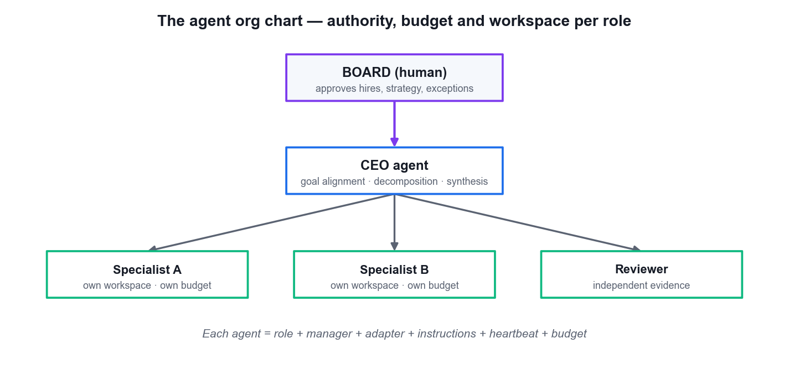
LO2 · ACCOUNTABILITY HAS A SHAPE
The Agent Org Chart
Board approves
Hires, strategy and material exceptions stay with the human.
The CEO owns alignment
Goal alignment, decomposition and final synthesis.
Specialists own transformations
One distinct job, one authority boundary, one deliverable.
Six fields per agent
Role · manager · adapter · instructions · heartbeat · budget.
Manage AI Agents with Paperclip (TGS-2023036646) · TGS-2023036646
© 2026 Tertiary Infotech Academy Pte Ltd
47

Slide 48
LO2 · WRITING THE ROLE
A Role Instruction Is a Contract, Not a Personality
Section
What it states
Why it matters
Purpose
The single transformation this role owns
Prevents scope drift
Allowed inputs
Which files, data and sources may be read
Confines the blast radius
Output schema
The artifact, its path and its required fields
Makes acceptance objective
Exclusions
What this role must never do
The most valuable section
Escalation
When to stop and ask the board
Keeps authority explicit
If two roles could both plausibly do the task, your instructions are not finished.
Manage AI Agents with Paperclip (TGS-2023036646) · TGS-2023036646
© 2026 Tertiary Infotech Academy Pte Ltd
48

Slide 49
LO2 · SEPARATE CONTEXT FROM AUTHORITY
Workspaces, Secrets and Skills
Dedicated workspace
One local root per role, isolated with git worktrees so every change is attributable to exactly one agent.
Git baseline
Commit an empty baseline so the later diff means what you think it means.
1
2
Secrets stay out
Credentials live in the runtime or the Paperclip secret store, injected at heartbeat time — never in prompts, notes or Git.
Skills are capability
Import a skill from a path or URL into the org-wide library, then attach it to a specific agent.
3
4
Adapters bridge capability
Match role complexity, session needs and tool access to the adapter you choose.
Prove it with a marker run
Configuration that has never produced an artifact is not a connection.
5
6
Manage AI Agents with Paperclip (TGS-2023036646) · TGS-2023036646
© 2026 Tertiary Infotech Academy Pte Ltd
49

Slide 50
WHAT YOU'LL DO
Hands-On Labs — Building AI Agents with Paperclip
Lab 2
Lab 3
—
• Create the BrightFunnel Company, Mission and CEO (Digital Marketing)
• BrightFunnel Marketing (Digital Marketing)
• Build the Meridian Reporting Tree and Validate Runtime Boundaries (Finance)
• Meridian Finance Desk (Finance)
• —
Manage AI Agents with Paperclip (TGS-2023036646) · TGS-2023036646
© 2026 Tertiary Infotech Academy Pte Ltd
50

Slide 51
LAB 2 · HANDS-ON
Create the BrightFunnel Company, Mission and CEO (Digital Marketing)
SIMULATED COMPANY · BrightFunnel Marketing (Digital Marketing)
You stand up BrightFunnel Marketing — a one-person digital marketing company — as a Paperclip company. You write a MEASURABLE mission (a target, a metric and a boundary), hire the Marketing Director as CEO, connect one trainer-approved agent runtime, and set the company budget cap BEFORE any agent is allowed to run. The order matters: a company that gains a runtime before it gains a cap can spend without a ceiling.
YOU'LL BUILD
MAPS TO
A BrightFunnel company in Paperclip with the exact synthetic mission, a hardened Marketing Director CEO on a verified adapter, a saved company budget cap, a dedicated workspace and a redacted configuration baseline in evidence/.
LO2: Create a goal-aligned Paperclip company with a measurable mission, a hardened CEO agent and enforced company-level caps.
Tools: Paperclip onboarding wizard, Agent Configuration, one approved adapter runtime, text editor
Full step-by-step procedure: Learner Guide, Lab 2 · labs/ folder
Manage AI Agents with Paperclip (TGS-2023036646) · TGS-2023036646
© 2026 Tertiary Infotech Academy Pte Ltd
51

Slide 52
LAB 2 · PROCESS MAP
How Lab 2 Runs
1
2
3
4
5
Create the company
Set the company cap
Hire the CEO
Write the role contract
Confine + verify runtime
the exact measurable mission
the outermost ring, before hiring
Marketing Director owns alignment
purpose, inputs, schema, exclusions
own workspace, then agent cap
THE POINT
LO2: Create a goal-aligned Paperclip company with a measurable mission, a hardened CEO agent and enforced company-level caps.
Manage AI Agents with Paperclip (TGS-2023036646) · TGS-2023036646
© 2026 Tertiary Infotech Academy Pte Ltd
52

Slide 53
LAB 2 · VERIFY
Create the BrightFunnel Company, Mission and CEO (Digital Marketing)
✅ Expected result
BrightFunnel exists with the exact mission text; the Marketing Director is the sole top-level agent with a verified adapter, a confined workspace and an instruction file; the agent cap (SGD 15) is below the company cap (SGD 40); and the baseline note contains no key, token or connection string.
IF IT DOESN'T WORK
The adapter verification fails
The mission field rejects the text
The budget cap will not save
Confirm the underlying CLI runtime is installed and authenticated OUTSIDE Paperclip first, then re-verify. Paperclip cannot authenticate a runtime for you.
Remove smart quotes and line breaks pasted from a word processor; enter the mission as plain text.
Set the company cap before the agent cap — an agent cap above a missing or smaller company cap is rejected.
Manage AI Agents with Paperclip (TGS-2023036646) · TGS-2023036646
© 2026 Tertiary Infotech Academy Pte Ltd
53

Slide 54
LAB 2 · TROUBLESHOOTING
Create the BrightFunnel Company, Mission and CEO (Digital Marketing)
⚠ The adapter verification fails
Confirm the underlying CLI runtime is installed and authenticated OUTSIDE Paperclip first, then re-verify. Paperclip cannot authenticate a runtime for you.
⚠ The mission field rejects the text
Remove smart quotes and line breaks pasted from a word processor; enter the mission as plain text.
⚠ The budget cap will not save
Set the company cap before the agent cap — an agent cap above a missing or smaller company cap is rejected.
CHALLENGE
REFLECTION
Rewrite the BrightFunnel mission so it would FAIL a feasibility scan, then state in one sentence exactly which property (target, metric or boundary) you removed.
Why is setting the company budget cap before hiring the CEO a control decision rather than an administrative one?
Manage AI Agents with Paperclip (TGS-2023036646) · TGS-2023036646
© 2026 Tertiary Infotech Academy Pte Ltd
54

Slide 55
LAB 3 · HANDS-ON
Build the Meridian Reporting Tree and Validate Runtime Boundaries (Finance)
SIMULATED COMPANY · Meridian Finance Desk (Finance)
You extend the pattern into Meridian Finance Desk and build a real three-agent org chart: a Finance Lead with an FP&A Analyst and a Treasury Analyst reporting to it. Each specialist receives its OWN workspace, its OWN instruction file and its OWN budget. You then prove every runtime boundary with a marker run — a deliberately trivial task whose only purpose is to produce an observable artifact in the correct workspace. Configuration that has never produced an artifact is not a connection.
YOU'LL BUILD
MAPS TO
A three-agent Meridian org chart with separate budgeted workspaces, role instruction files, clean Git baselines and one marker-run artifact per agent proving its runtime boundary.
LO2: Build a multi-agent reporting hierarchy with distinct, budgeted and confined workspaces, and prove each runtime boundary with a marker run.
Tools: Paperclip Agents, Org and Runs pages; approved adapter runtime; Git; Markdown editor
Full step-by-step procedure: Learner Guide, Lab 3 · labs/ folder
Manage AI Agents with Paperclip (TGS-2023036646) · TGS-2023036646
© 2026 Tertiary Infotech Academy Pte Ltd
55

Slide 56
LAB 3 · PROCESS MAP
How Lab 3 Runs
1
2
3
4
5
Create Meridian
Hire the tree
Split the workspaces
Git baseline each root
Marker run per agent
company mission and cap
two analysts report to the lead
one root per role
so the diff means something
prove the runtime boundary
THE POINT
LO2: Build a multi-agent reporting hierarchy with distinct, budgeted and confined workspaces, and prove each runtime boundary with a marker run.
Manage AI Agents with Paperclip (TGS-2023036646) · TGS-2023036646
© 2026 Tertiary Infotech Academy Pte Ltd
56

Slide 57
LAB 3 · VERIFY
Build the Meridian Reporting Tree and Validate Runtime Boundaries (Finance)
✅ Expected result
paperclip → Org shows a three-agent tree with both analysts reporting to the Finance Lead; each workspace contains exactly ONE marker.md attributable to its own agent; every agent has an individual cap and the sum of agent caps does not exceed the company cap; and each marker run has a recorded run ID.
IF IT DOESN'T WORK
A marker file appears in the wrong workspace
A specialist never wakes
Git reports the workspace is dirty before the marker run
The agent's workspace path is misbound. Correct the path on the AGENT (not the company), delete the stray file, and re-run the marker.
Confirm the issue is ASSIGNED to that agent — creating an issue does not wake anyone. Then check the agent's adapter verification and its budget headroom.
Something was written outside a run. Reset to the baseline commit and re-run so the diff means what you think it means.
Manage AI Agents with Paperclip (TGS-2023036646) · TGS-2023036646
© 2026 Tertiary Infotech Academy Pte Ltd
57

Slide 58
LAB 3 · TROUBLESHOOTING
Build the Meridian Reporting Tree and Validate Runtime Boundaries (Finance)
⚠ A marker file appears in the wrong workspace
The agent's workspace path is misbound. Correct the path on the AGENT (not the company), delete the stray file, and re-run the marker.
⚠ A specialist never wakes
Confirm the issue is ASSIGNED to that agent — creating an issue does not wake anyone. Then check the agent's adapter verification and its budget headroom.
⚠ Git reports the workspace is dirty before the marker run
Something was written outside a run. Reset to the baseline commit and re-run so the diff means what you think it means.
CHALLENGE
REFLECTION
Set the Treasury Analyst's cap to SGD 0.01, re-run its marker task, and record exactly where and how Paperclip reports the budget stop.
Why is a marker run stronger evidence of a working runtime than a green 'connection verified' badge in the configuration screen?
Manage AI Agents with Paperclip (TGS-2023036646) · TGS-2023036646
© 2026 Tertiary Infotech Academy Pte Ltd
58

Slide 59
TOPIC RECAP
Recap — Building AI Agents with Paperclip
• You can now: LO2: Create a goal-aligned Paperclip company with a measurable mission, a hardened CEO agent and enforced company-level caps.
• You can now: LO2: Build a multi-agent reporting hierarchy with distinct, budgeted and confined workspaces, and prove each runtime boundary with a marker run.
• Onboarding with paperclipai onboard --yes downloads Paperclip, writes the configuration, initialises the embedded PostgreSQL and serves the UI on port 3100.
• Bind mode is a security decision: the default trusted loopback is the least exposed; --bind lan and --bind tailnet widen reach and require authentication.
• The onboarding wizard captures the company name, the mission statement and the team lead, then verifies connectivity to your chosen local agent runtime.
Manage AI Agents with Paperclip (TGS-2023036646) · TGS-2023036646
© 2026 Tertiary Infotech Academy Pte Ltd
59

Slide 60
03
TOPIC 03
Developing Intelligent Multi-Agent Systems
Projects, goals and lineage · issue decomposition · assignment and hand-off · sequential specialists · verifying between disparate components
Manage AI Agents with Paperclip (TGS-2023036646) · TGS-2023036646
© 2026 Tertiary Infotech Academy Pte Ltd
60

Slide 61
TOPIC WEIGHTING 25%
Key Concepts — Developing Intelligent Multi-Agent Systems
Projects hold goals and issues and supply the context an agent reads at runtime, so tasks carry full goal ancestry — the agent sees why, not only what.
Goal lineage flows downward: company mission → project goal → parent issue → child issue. An agent that cannot trace its lineage is working without direction.
1
2
Decompose into a parent synthesis issue plus specialist child issues. Create every issue unassigned first, so creation cannot accidentally wake an agent.
Assignment is the trigger. Assign one child at a time to keep runs sequential, observable and individually attributable.
3
4
Manage AI Agents with Paperclip (TGS-2023036646) · TGS-2023036646
© 2026 Tertiary Infotech Academy Pte Ltd
61

Slide 62
TOPIC WEIGHTING 25%
Key Concepts — Developing Intelligent Multi-Agent Systems (continued)
An acceptance criterion must name the evidence: which artifact, at which path, containing which fields — never 'the research is done'.
A hand-off is accepted only when the receiving agent can consume the artifact without asking the producer a question.
1
2
Verification between disparate components means tracing one thread across issue ID, run log, comment, workspace diff and cost entry, and finding them consistent.
Status is not evidence. An issue marked Done with no linked artifact and no diff is an unverified claim.
3
4
Manage AI Agents with Paperclip (TGS-2023036646) · TGS-2023036646
© 2026 Tertiary Infotech Academy Pte Ltd
62

Slide 63
TOPIC WEIGHTING 25%
Key Concepts — Developing Intelligent Multi-Agent Systems (continued)
Explicit limitations are part of a good deliverable — an agent that reports what it could not establish is more useful than one that quietly guesses.
One event should not create many outcomes: choose a single trigger for the first controlled run and keep the work idempotent.
1
2
Bound every wait. An unbounded wait for a heartbeat hides a failed adapter behind what looks like patience.
The workspace diff is the strongest evidence you have — read what actually changed on disk before accepting any agent's summary of it.
3
4
Manage AI Agents with Paperclip (TGS-2023036646) · TGS-2023036646
© 2026 Tertiary Infotech Academy Pte Ltd
63

Slide 64
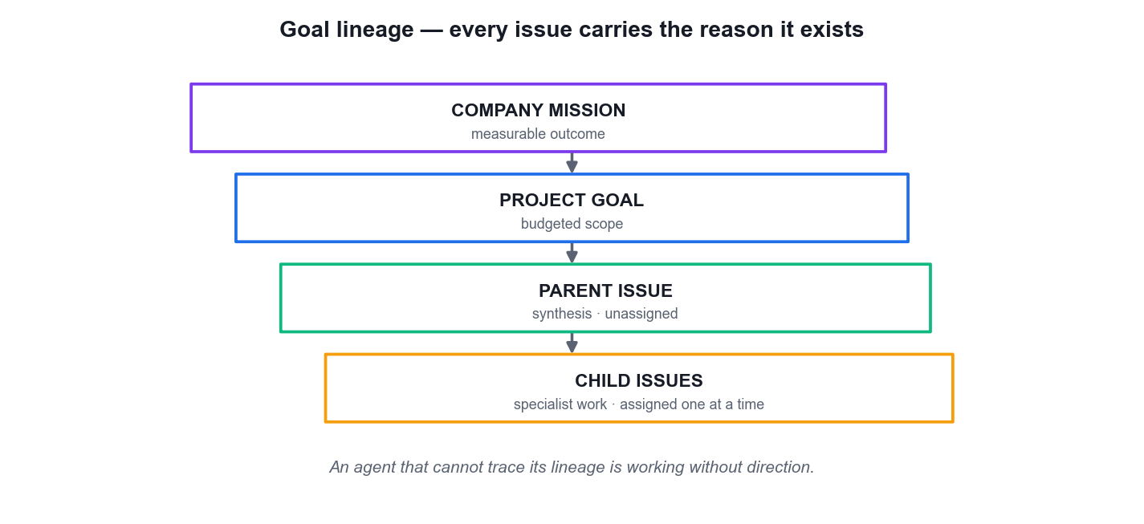
LO3 · THE AGENT SEES WHY, NOT ONLY WHAT
Goal Lineage — Every Issue Carries Its Reason
Mission
One measurable outcome defines why the company exists.
Project goal
A budgeted scope the agent reads at runtime.
Parent issue
The synthesis — created unassigned so it cannot wake early.
Child issues
Specialist work, assigned ONE AT A TIME.
Manage AI Agents with Paperclip (TGS-2023036646) · TGS-2023036646
© 2026 Tertiary Infotech Academy Pte Ltd
64

Slide 65
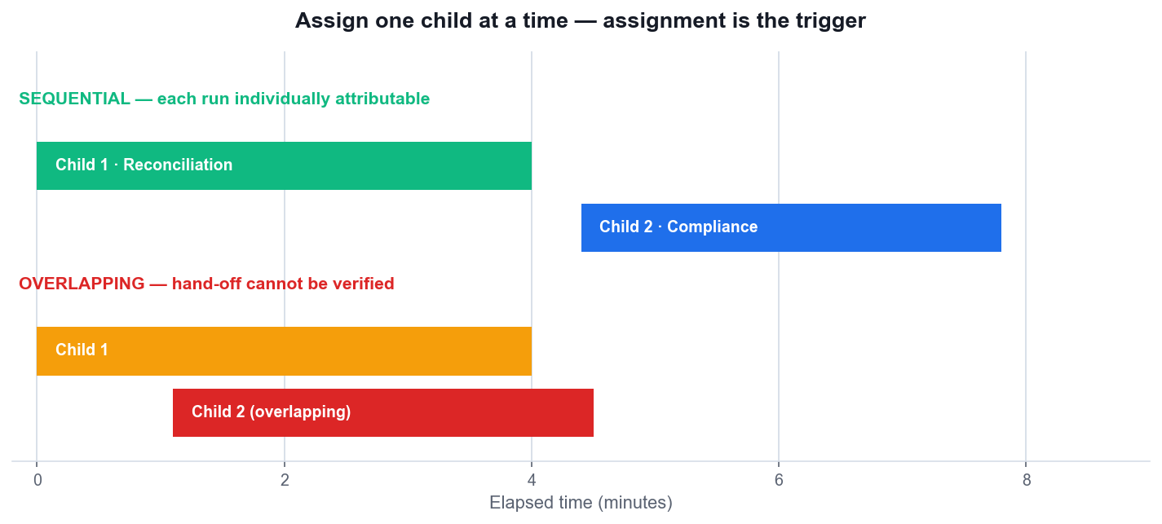
LO3 · WHY SEQUENCE MATTERS
Assign One Child at a Time
Assignment is the trigger
Creating an issue does not wake anyone — assigning it does.
Sequential = attributable
Non-overlapping runs let you tie each artifact to exactly one run.
Overlapping = unverifiable
If both ran at once you cannot prove the hand-off actually happened.
Bound every wait
An unbounded wait hides a failed adapter behind apparent patience.
Manage AI Agents with Paperclip (TGS-2023036646) · TGS-2023036646
© 2026 Tertiary Infotech Academy Pte Ltd
65

Slide 66
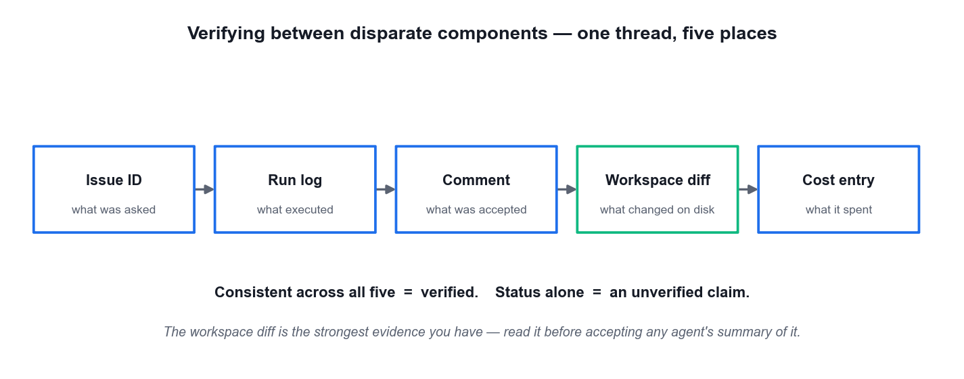
LO3 · WHAT 'VERIFIED' ACTUALLY MEANS
Verifying Between Disparate Components
Five places, one thread
Issue ID, run log, comment, workspace diff and cost entry must agree.
The diff is king
Read what actually changed on disk before accepting any agent's summary.
Status is not evidence
'Done' with no artifact and no diff is an unverified claim.
Name the evidence
An acceptance criterion states the artifact, its path and its fields.
Manage AI Agents with Paperclip (TGS-2023036646) · TGS-2023036646
© 2026 Tertiary Infotech Academy Pte Ltd
66

Slide 67
LO3 · ACCEPTING WORK
Hand-Off Acceptance — What You Are Actually Checking
Consumable without a question
The receiving agent can use the artifact without asking the producer anything.
Limitations stated
An agent that reports what it could NOT establish is more useful than one that quietly guesses.
1
2
Idempotent
One event should not create many outcomes — re-running must not duplicate the work.
Traceable
Every claim in the deliverable points back to a named source in the allowed inputs.
3
4
Accept artifacts and explicit limitations — never a status change on its own.
Manage AI Agents with Paperclip (TGS-2023036646) · TGS-2023036646
© 2026 Tertiary Infotech Academy Pte Ltd
67

Slide 68
WHAT YOU'LL DO
Hands-On Labs — Developing Intelligent Multi-Agent Systems
Lab 4
Lab 5
—
• Translate the Ledgerly Mission into Assigned Issues and Hand-Offs (Accounting)
• Ledgerly Accounting (Accounting)
• Verify NorthPoint Routines and Layered Budget Controls (Stock Trading Research)
• NorthPoint Trading Research (Stock Trading — research only)
• —
Manage AI Agents with Paperclip (TGS-2023036646) · TGS-2023036646
© 2026 Tertiary Infotech Academy Pte Ltd
68

Slide 69
LAB 4 · HANDS-ON
Translate the Ledgerly Mission into Assigned Issues and Hand-Offs (Accounting)
SIMULATED COMPANY · Ledgerly Accounting (Accounting)
You turn the Ledgerly Accounting mission into actual work. You create a budgeted month-end close project, then a PARENT synthesis issue and two specialist CHILD issues — all created UNASSIGNED, so that creating work cannot accidentally wake an agent. Only after every acceptance criterion names its evidence do you assign one child at a time. This is the core discipline of the topic: assignment is the trigger, and sequential assignment is what makes each run individually verifiable.
YOU'LL BUILD
MAPS TO
A capped Ledgerly close project with an unassigned parent issue, two sequentially completed specialist children, clean workspace manifests, and an evidence record linking issue IDs, run IDs, comments, statuses and artifact paths.
LO3: Decompose a mission into a parent and specialist child issues, run the specialists sequentially and verify each hand-off against acceptance evidence.
Tools: Paperclip Projects, Budgets, Issues, Agents and Runs; approved adapter runtime; Git; Markdown workspaces
Full step-by-step procedure: Learner Guide, Lab 4 · labs/ folder
Manage AI Agents with Paperclip (TGS-2023036646) · TGS-2023036646
© 2026 Tertiary Infotech Academy Pte Ltd
69

Slide 70
LAB 4 · PROCESS MAP
How Lab 4 Runs
1
2
3
4
5
Create the close project
Parent issue, unassigned
Two child issues
Assign child 1 only
Accept, then assign child 2
its own budget cap
creation must not wake anyone
acceptance names the evidence
assignment is the trigger
sequential and attributable
THE POINT
LO3: Decompose a mission into a parent and specialist child issues, run the specialists sequentially and verify each hand-off against acceptance evidence.
Manage AI Agents with Paperclip (TGS-2023036646) · TGS-2023036646
© 2026 Tertiary Infotech Academy Pte Ltd
70

Slide 71
LAB 4 · VERIFY
Translate the Ledgerly Mission into Assigned Issues and Hand-Offs (Accounting)
✅ Expected result
The Ledgerly project shows a saved cap above actual spend; the parent issue is still open and unassigned; both children are Done with a linked artifact and a recorded run ID; the two specialists ran SEQUENTIALLY (non-overlapping run timestamps); and the exceptions file demonstrably references the reconciliation figures.
IF IT DOESN'T WORK
Both specialists wake at the same time
The child artifact exists but is missing fields
The parent issue wakes unexpectedly
A child was assigned before the previous one was accepted. Pause the second agent, let the first run settle, then re-assign so the runs are sequential.
The acceptance criterion was written as an activity, not as evidence. Rewrite it naming the required fields and re-run — do not hand-edit the agent's artifact.
It was assigned during creation. Clear the assignee; the parent stays unassigned until both children are accepted (that is Lab 6).
Manage AI Agents with Paperclip (TGS-2023036646) · TGS-2023036646
© 2026 Tertiary Infotech Academy Pte Ltd
71

Slide 72
LAB 4 · TROUBLESHOOTING
Translate the Ledgerly Mission into Assigned Issues and Hand-Offs (Accounting)
⚠ Both specialists wake at the same time
A child was assigned before the previous one was accepted. Pause the second agent, let the first run settle, then re-assign so the runs are sequential.
⚠ The child artifact exists but is missing fields
The acceptance criterion was written as an activity, not as evidence. Rewrite it naming the required fields and re-run — do not hand-edit the agent's artifact.
⚠ The parent issue wakes unexpectedly
It was assigned during creation. Clear the assignee; the parent stays unassigned until both children are accepted (that is Lab 6).
CHALLENGE
REFLECTION
Add a third child issue whose acceptance criterion deliberately names an artifact the previous child never produces, and record precisely how the failure surfaces in the run log.
Why does creating every issue unassigned change the risk profile of a multi-agent company, compared with assigning at creation time?
Manage AI Agents with Paperclip (TGS-2023036646) · TGS-2023036646
© 2026 Tertiary Infotech Academy Pte Ltd
72

Slide 73
LAB 5 · HANDS-ON
Verify NorthPoint Routines and Layered Budget Controls (Stock Trading Research)
SIMULATED COMPANY · NorthPoint Trading Research (Stock Trading — research only)
NorthPoint Trading Research needs a daily pre-market brief — which makes it the right place to learn routines. You create the readiness routine PAUSED, add an explicit cron trigger with an IANA timezone, prove the routine once by hand, and leave it paused afterwards. You then verify all three budget layers against actual recorded spend. The rule the lab teaches: automation earns the schedule only after a human has watched it succeed once. This is research only — the company never places or recommends a trade.
YOU'LL BUILD
MAPS TO
A paused NorthPoint readiness routine with a saved 07:00 Asia/Singapore trigger, exactly one reviewed manual run, and a control table proving company, project and agent budget layers all remain above recorded spend.
LO3: Test a scheduled routine and verify that every budget layer holds, using one bounded manual run before automation is allowed to own the schedule.
Tools: Paperclip Routines, Costs and Budgets, Agent Budget tabs, Project settings, Activity
Full step-by-step procedure: Learner Guide, Lab 5 · labs/ folder
Manage AI Agents with Paperclip (TGS-2023036646) · TGS-2023036646
© 2026 Tertiary Infotech Academy Pte Ltd
73

Slide 74
LAB 5 · PROCESS MAP
How Lab 5 Runs
1
2
3
4
5
Create NorthPoint
Create the routine PAUSED
Add the cron trigger
Run once, bounded
Check every budget layer
research only — never a trade
unproven automation stays off
0 7 * * * with Asia/Singapore
the human review earns the schedule
company, project and agent
THE POINT
LO3: Test a scheduled routine and verify that every budget layer holds, using one bounded manual run before automation is allowed to own the schedule.
Manage AI Agents with Paperclip (TGS-2023036646) · TGS-2023036646
© 2026 Tertiary Infotech Academy Pte Ltd
74

Slide 75
LAB 5 · VERIFY
Verify NorthPoint Routines and Layered Budget Controls (Stock Trading Research)
✅ Expected result
The routine carries an explicit 0 7 * * * Asia/Singapore trigger, has exactly ONE successful reviewed manual run, and finishes PAUSED; the brief exists and cites only the synthetic data with limitations stated and no trade recommendation; and the control table shows all three budget layers above recorded spend.
IF IT DOESN'T WORK
The routine fires unexpectedly
The cost shows as zero
The timezone reverts or the schedule fires an hour out
It was left active after the manual run. Pause it, then check the activity log for any additional runs and record them — do not delete the evidence.
The run may have failed before invoking the runtime. Read the run log for an adapter error rather than assuming the work was free.
The trigger was saved without an explicit IANA timezone and inherited the host's. Re-save the trigger with Asia/Singapore stated explicitly.
Manage AI Agents with Paperclip (TGS-2023036646) · TGS-2023036646
© 2026 Tertiary Infotech Academy Pte Ltd
75

Slide 76
LAB 5 · TROUBLESHOOTING
Verify NorthPoint Routines and Layered Budget Controls (Stock Trading Research)
⚠ The routine fires unexpectedly
It was left active after the manual run. Pause it, then check the activity log for any additional runs and record them — do not delete the evidence.
⚠ The cost shows as zero
The run may have failed before invoking the runtime. Read the run log for an adapter error rather than assuming the work was free.
⚠ The timezone reverts or the schedule fires an hour out
The trigger was saved without an explicit IANA timezone and inherited the host's. Re-save the trigger with Asia/Singapore stated explicitly.
CHALLENGE
REFLECTION
Lower the Market Data Analyst cap below the recorded run cost, run the routine once more, and record exactly which layer stops the run and where it is reported.
Why must a routine be proved by one bounded manual run before the schedule is allowed to own it?
Manage AI Agents with Paperclip (TGS-2023036646) · TGS-2023036646
© 2026 Tertiary Infotech Academy Pte Ltd
76

Slide 77
TOPIC RECAP
Recap — Developing Intelligent Multi-Agent Systems
• You can now: LO3: Decompose a mission into a parent and specialist child issues, run the specialists sequentially and verify each hand-off against acceptance evidence.
• You can now: LO3: Test a scheduled routine and verify that every budget layer holds, using one bounded manual run before automation is allowed to own the schedule.
• Projects hold goals and issues and supply the context an agent reads at runtime, so tasks carry full goal ancestry — the agent sees why, not only what.
• Goal lineage flows downward: company mission → project goal → parent issue → child issue. An agent that cannot trace its lineage is working without direction.
• Decompose into a parent synthesis issue plus specialist child issues. Create every issue unassigned first, so creation cannot accidentally wake an agent.
Manage AI Agents with Paperclip (TGS-2023036646) · TGS-2023036646
© 2026 Tertiary Infotech Academy Pte Ltd
77

Slide 78
04
TOPIC 04
Deploying and Managing AI Agents
Routines and schedules · layered budgets · approvals and audit · operator intervention · deployment, portability and troubleshooting
Manage AI Agents with Paperclip (TGS-2023036646) · TGS-2023036646
© 2026 Tertiary Infotech Academy Pte Ltd
78

Slide 79
TOPIC WEIGHTING 25%
Key Concepts — Deploying and Managing AI Agents
A routine is recurring work triggered by cron, webhook or API. Create it paused, prove it once by hand, and only then let the schedule own it.
A schedule trigger is explicit — 30 16 * * * with an IANA timezone such as Asia/Singapore. An implicit timezone is a production incident waiting to happen.
1
2
Budgets are layered: company, project, agent. Enforcement happens at checkout, so a runaway loop stops at the ceiling instead of after you read the invoice.
Treat the budget as a two-stage circuit breaker — warn, then stop — and record the baseline spend and expected run frequency before you rely on it.
3
4
Manage AI Agents with Paperclip (TGS-2023036646) · TGS-2023036646
© 2026 Tertiary Infotech Academy Pte Ltd
79

Slide 80
TOPIC WEIGHTING 25%
Key Concepts — Deploying and Managing AI Agents (continued)
Cost is tracked at token level by provider, model, agent and project, which is what makes the per-agent cap meaningful rather than notional.
Approvals are the board's authority made explicit: the agent proposes a hire, a strategy or a risky action, and a human decides with a recorded rationale.
1
2
The activity log is a durable record of mutations, heartbeats, cost events and approvals — the audit loop closes when the whole operation reconstructs from it.
Use the least irreversible control first: inspect, then pause, then reassign, then terminate. Retirement is the last rung of the ladder, not the first.
3
4
Manage AI Agents with Paperclip (TGS-2023036646) · TGS-2023036646
© 2026 Tertiary Infotech Academy Pte Ltd
80

Slide 81
TOPIC WEIGHTING 25%
Key Concepts — Deploying and Managing AI Agents (continued)
Deployment options run from local loopback through LAN or tailnet binding to a hosted container with an external PostgreSQL and a persistent volume.
A production deployment needs the signing secret for tool approvals, the allowed hostnames list and a health check on /api/health.
1
2
Portability means an entire company exports and imports with secrets scrubbed and collisions handled — the org chart is data, not a hand-built configuration.
Troubleshooting is a discipline: reproduce, isolate the layer, change one setting, re-verify with evidence, and record what the fix actually proved.
3
4
Manage AI Agents with Paperclip (TGS-2023036646) · TGS-2023036646
© 2026 Tertiary Infotech Academy Pte Ltd
81

Slide 82
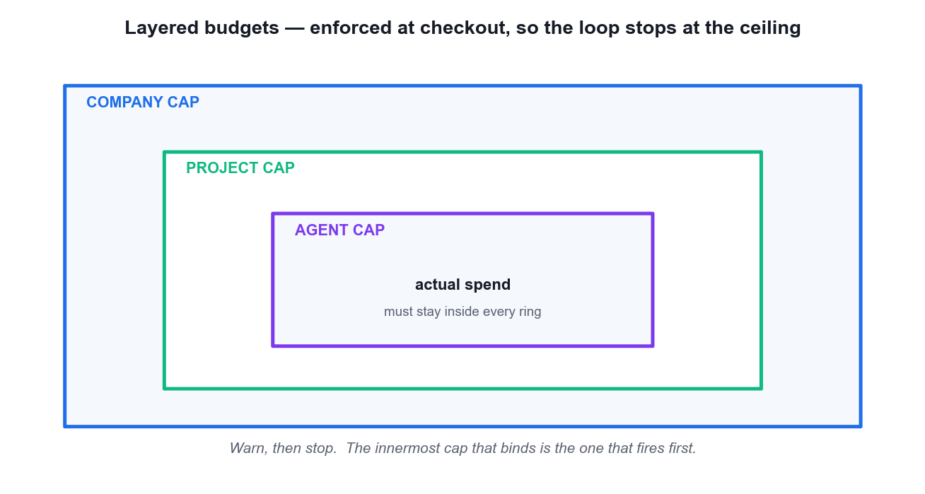
LO4 · COST CONTROL AS A CIRCUIT BREAKER
Layered Budgets — Warn, Then Stop
Three rings
Company, project and agent — the innermost cap that binds fires first.
Enforced at checkout
Not at billing. The loop stops at the ceiling.
Baseline first
Record current spend and expected run frequency before you rely on a cap.
Token-level costing
Tracked by provider, model, agent and project — which is what makes the cap meaningful.
Manage AI Agents with Paperclip (TGS-2023036646) · TGS-2023036646
© 2026 Tertiary Infotech Academy Pte Ltd
82

Slide 83
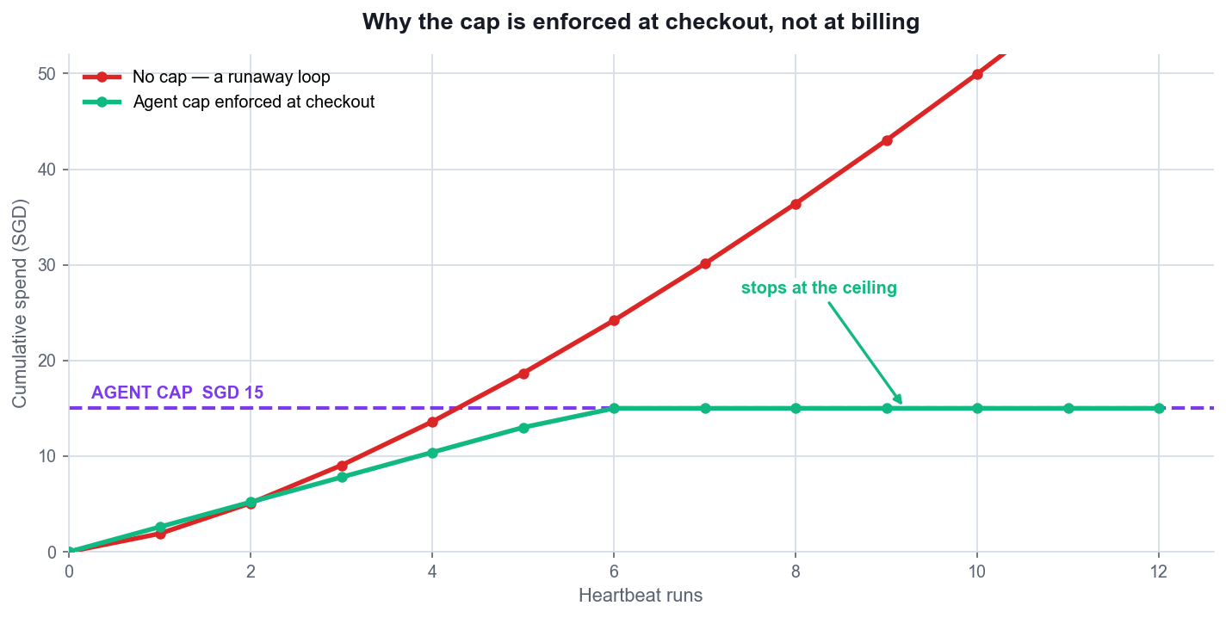
LO4 · THE ENGINEERING ARGUMENT
Why the Cap Is Enforced at Checkout
Without a cap
A runaway loop keeps spending until someone notices the invoice.
With a cap
Spend flattens at the ceiling and the agent simply stops.
The cap is a control
Not a budget estimate — it is the thing that makes unattended operation safe.
Set it below the pain
A cap you would be unhappy to actually pay is set too high.
Manage AI Agents with Paperclip (TGS-2023036646) · TGS-2023036646
© 2026 Tertiary Infotech Academy Pte Ltd
83

Slide 84
LO4 · SCHEDULED WORK
Routines — Automation Earns the Schedule
Create it PAUSED
A routine live before it has ever succeeded is unreviewed scheduled spend.
State the trigger explicitly
30 16 * * * WITH an IANA timezone such as Asia/Singapore.
1
2
Prove it once by hand
One bounded manual run, reviewed by a human.
Leave it paused
Until you have read the generated issue, the run and the cost.
3
4
Name the artifact
The routine body must state what file it produces, or the run is unverifiable.
Watch for concurrency
One event should not create many outcomes.
5
6
An implicit timezone is a production incident waiting to happen.
Manage AI Agents with Paperclip (TGS-2023036646) · TGS-2023036646
© 2026 Tertiary Infotech Academy Pte Ltd
84

Slide 85
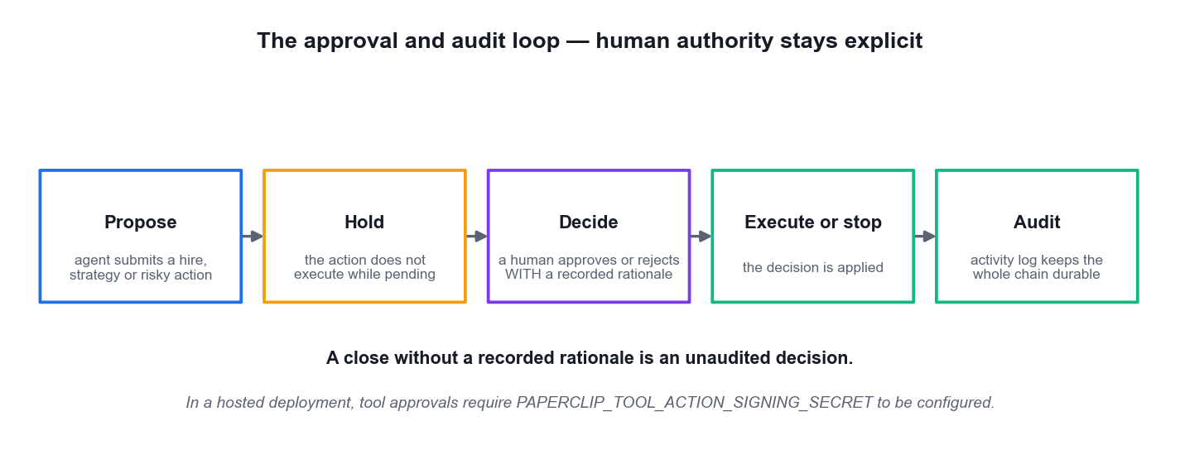
LO4 · HUMAN AUTHORITY STAYS EXPLICIT
The Approval and Audit Loop
Propose, then hold
The governed action does not execute while it is pending.
A human decides
With a RECORDED rationale — that sentence is the audit.
The log is durable
Mutations, heartbeats, cost events and approvals all land in Activity.
The loop closes
When the whole operation can be reconstructed from the log alone.
Manage AI Agents with Paperclip (TGS-2023036646) · TGS-2023036646
© 2026 Tertiary Infotech Academy Pte Ltd
85

Slide 86
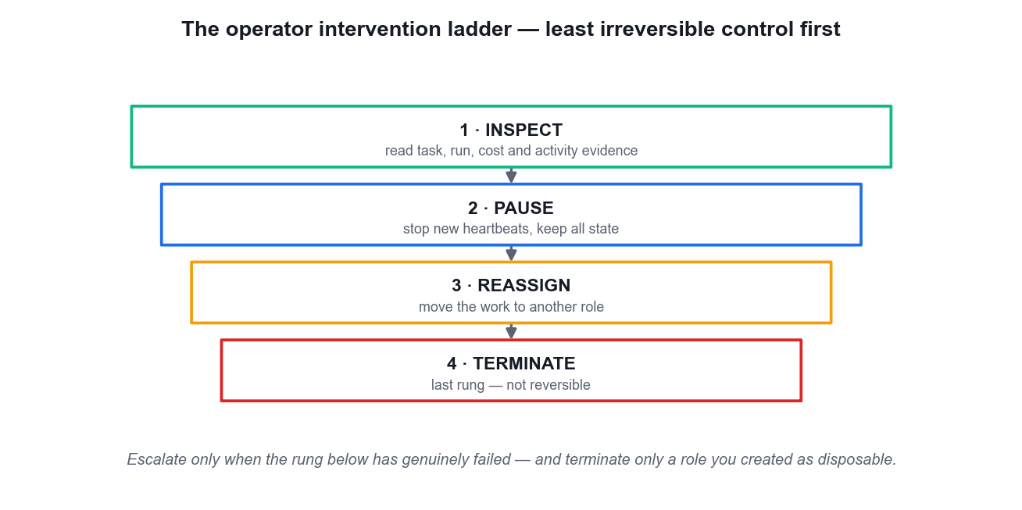
LO4 · USE THE LEAST IRREVERSIBLE CONTROL
The Operator Intervention Ladder
Inspect
Read task, run, cost and activity evidence BEFORE acting.
Pause
Stop new heartbeats while keeping all state.
Reassign
Move the work to another role.
Terminate
The last rung — and it is not reversible.
Manage AI Agents with Paperclip (TGS-2023036646) · TGS-2023036646
© 2026 Tertiary Infotech Academy Pte Ltd
86

Slide 87
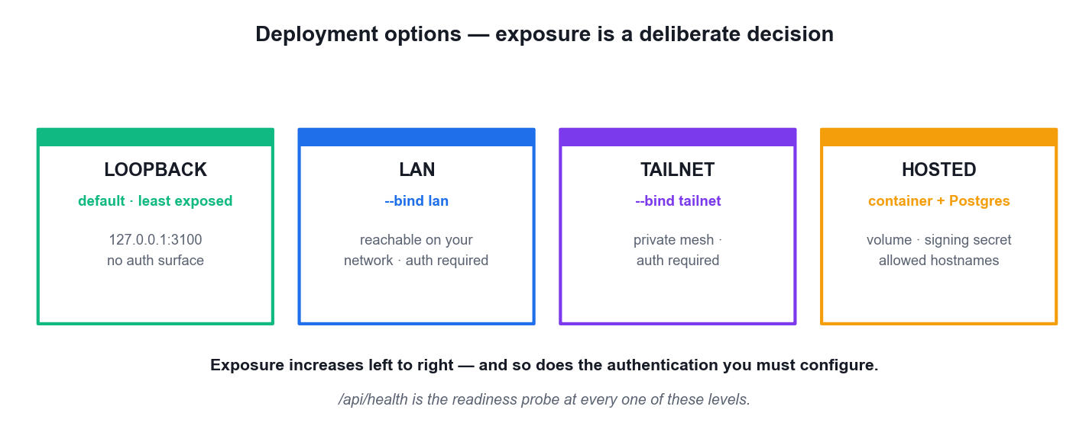
LO4 · TAKING IT BEYOND THE LAPTOP
Deployment Options — Exposure Is a Decision
Loopback
The default and least exposed — trusted local only.
LAN / tailnet
--bind lan or --bind tailnet widen reach and REQUIRE authentication.
Hosted
Container plus external PostgreSQL, a persistent volume, a signing secret and an allowed-hostnames list.
Portability
A whole company exports and imports with secrets scrubbed and collisions re-mapped.
Manage AI Agents with Paperclip (TGS-2023036646) · TGS-2023036646
© 2026 Tertiary Infotech Academy Pte Ltd
87

Slide 88
WHAT YOU'LL DO
Hands-On Labs — Deploying and Managing AI Agents
Lab 6
—
—
• Run the Governed TalentBridge Operation and Close the Audit Loop (HR)
• TalentBridge People Ops (HR — sourcing, interview, policy, onboarding)
• —
• —
Manage AI Agents with Paperclip (TGS-2023036646) · TGS-2023036646
© 2026 Tertiary Infotech Academy Pte Ltd
88

Slide 89
LAB 6 · HANDS-ON
Run the Governed TalentBridge Operation and Close the Audit Loop (HR)
SIMULATED COMPANY · TalentBridge People Ops (HR — sourcing, interview, policy, onboarding)
TalentBridge People Ops is the highest-stakes simulation in the course: hiring decisions affect real people, so every control you have learned is now mandatory rather than advisable. You complete the sourcing-to-onboarding operation, review the final synthesis against a workspace DIFF before the board closes it, process a bounded hire approval with a recorded rationale, practise the intervention ladder on a disposable role only, and finally reconstruct the entire operation from the activity log. The audit loop closes when the log alone tells the whole story.
YOU'LL BUILD
MAPS TO
A diff-reviewed TalentBridge hiring brief, a separately confined reviewer with a recorded approval rationale, a lifecycle intervention record, and a mission-to-evidence audit map reconstructed from the activity log alone.
LO4: Resolve issues and modify a running agent company through approvals, the operator intervention ladder and a reconstructed audit trail.
Tools: Paperclip Issues, Agents, Runs, Approvals, Activity, Costs and local Markdown artifacts
Full step-by-step procedure: Learner Guide, Lab 6 · labs/ folder
Manage AI Agents with Paperclip (TGS-2023036646) · TGS-2023036646
© 2026 Tertiary Infotech Academy Pte Ltd
89

Slide 90
LAB 6 · PROCESS MAP
How Lab 6 Runs
1
2
3
4
5
Create TalentBridge
Run the issue tree
Review the workspace diff
Decide the approval
Close the audit loop
synthetic candidates only
children accepted before the parent
not the agent's own summary
record the rationale
reconstruct from Activity alone
THE POINT
LO4: Resolve issues and modify a running agent company through approvals, the operator intervention ladder and a reconstructed audit trail.
Manage AI Agents with Paperclip (TGS-2023036646) · TGS-2023036646
© 2026 Tertiary Infotech Academy Pte Ltd
90

Slide 91
LAB 6 · VERIFY
Run the Governed TalentBridge Operation and Close the Audit Loop (HR)
✅ Expected result
The hiring brief is the only later People Ops Lead workspace change and its diff passes the rubric-traceability and fairness checks; the approval carries a recorded rationale; the intervention ladder was applied to the disposable role only and in order; and the audit map reconstructs every mission claim from activity-log entries with no gap.
IF IT DOESN'T WORK
The CEO synthesises incomplete work
The approval cannot be decided
Terminate removes more than intended
The parent was assigned before both children were accepted. Reopen the parent, accept the outstanding child on named evidence, then re-assign.
In a hosted deployment the tool-action signing secret must be configured, or approvals stay pending. Check PAPERCLIP_TOOL_ACTION_SIGNING_SECRET.
Terminate is the LAST rung and is not reversible. Pause and reassign first; only terminate the role you deliberately created as disposable.
Manage AI Agents with Paperclip (TGS-2023036646) · TGS-2023036646
© 2026 Tertiary Infotech Academy Pte Ltd
91

Slide 92
LAB 6 · TROUBLESHOOTING
Run the Governed TalentBridge Operation and Close the Audit Loop (HR)
⚠ The CEO synthesises incomplete work
The parent was assigned before both children were accepted. Reopen the parent, accept the outstanding child on named evidence, then re-assign.
⚠ The approval cannot be decided
In a hosted deployment the tool-action signing secret must be configured, or approvals stay pending. Check PAPERCLIP_TOOL_ACTION_SIGNING_SECRET.
⚠ Terminate removes more than intended
Terminate is the LAST rung and is not reversible. Pause and reassign first; only terminate the role you deliberately created as disposable.
⚠ The activity log has a gap
Work was done outside a run — for example hand-edited in the workspace. Note it honestly in the audit map; an unexplained gap is itself an audit finding.
CHALLENGE
REFLECTION
Export the TalentBridge company, confirm the export scrubs secrets, then import it as a second company and record which identifiers Paperclip had to re-map on collision.
Your audit map is the deliverable a regulator would actually ask for. Which single row in it is the weakest, and what evidence would strengthen it?
Manage AI Agents with Paperclip (TGS-2023036646) · TGS-2023036646
© 2026 Tertiary Infotech Academy Pte Ltd
92

Slide 93
TOPIC RECAP
Recap — Deploying and Managing AI Agents
• You can now: LO4: Resolve issues and modify a running agent company through approvals, the operator intervention ladder and a reconstructed audit trail.
• A routine is recurring work triggered by cron, webhook or API. Create it paused, prove it once by hand, and only then let the schedule own it.
• A schedule trigger is explicit — 30 16 * * * with an IANA timezone such as Asia/Singapore. An implicit timezone is a production incident waiting to happen.
• Budgets are layered: company, project, agent. Enforcement happens at checkout, so a runaway loop stops at the ceiling instead of after you read the invoice.
Manage AI Agents with Paperclip (TGS-2023036646) · TGS-2023036646
© 2026 Tertiary Infotech Academy Pte Ltd
93

Slide 94
WRAP-UP
Course Summary & Next Steps
Manage AI Agents with Paperclip (TGS-2023036646) · TGS-2023036646
© 2026 Tertiary Infotech Academy Pte Ltd
94

Slide 95
LEARNING OUTCOMES
What You Achieved
LO1 · Identify & scan feasibility
Explain the Paperclip control-plane model and judge when a managed multi-agent company earns its coordination cost.
LO2 · Integrate & develop
Install Paperclip, create a goal-aligned company, build the reporting tree and connect agent runtimes, skills and workspaces safely.
1
2
LO3 · Test & verify
Decompose a mission into issues, run bounded heartbeats and verify hand-offs through runs, comments, artifacts and the activity log.
LO4 · Resolve & modify
Diagnose adapter, budget and routine failures, and modify governance, approvals and cost boundaries to keep the operation safe.
3
4
Manage AI Agents with Paperclip (TGS-2023036646) · TGS-2023036646
© 2026 Tertiary Infotech Academy Pte Ltd
95

Slide 96
TAKE THIS BACK TO WORK
A Governed Multi-Agent Operating Checklist
Mission is measurable
A target, a metric and a boundary — or it cannot be verified.
Caps exist before runtimes
Company, then project, then agent — set before anything runs.
1
2
Every role is confined
Its own workspace, instruction file, adapter and budget.
Issues are created unassigned
Assignment is the trigger; assign one at a time.
3
4
Acceptance names the evidence
The artifact, its path and its required fields.
The audit reconstructs
Activity alone tells the whole story, with no unexplained gap.
5
6
Manage AI Agents with Paperclip (TGS-2023036646) · TGS-2023036646
© 2026 Tertiary Infotech Academy Pte Ltd
96

Slide 97
NEXT STEPS
Continue Your Learning
Official project
https://github.com/paperclipai/paperclip — the source, the docs and the release notes.
Hosted Paperclip
https://paperclip.inc — the managed control plane if you do not want to self-host.
1
2
Rebuild the labs
Redo each of the six companies from scratch until the control sequence is automatic.
Start with one real workflow
Choose an internal task whose inputs and outputs are already observable.
3
4
Keep the caps low
Your first real company should be capped far below what you would be willing to pay.
Audit before you scale
Prove you can reconstruct one operation before you run two.
5
6
Manage AI Agents with Paperclip (TGS-2023036646) · TGS-2023036646
© 2026 Tertiary Infotech Academy Pte Ltd
97

Slide 98
CONTINUE WITH TERTIARY INFOTECH
Recommended Courses
1
WSQ - Develop Multi AI Agent Applications with Gemini Agent ADK
2
WSQ - Build LLM Applications Using Flowise and LangChain
3
WSQ - Generative AI for Productivity
4
WSQ - Prompt Engineering for Business
Manage AI Agents with Paperclip (TGS-2023036646) · TGS-2023036646
© 2026 Tertiary Infotech Academy Pte Ltd
98

Slide 99
WE'RE HERE TO HELP — DURING AND AFTER THE CLASS
Support
Email
enquiry@tertiaryinfotech.com
Telephone
+65 6100 0613
1
2
Website
www.tertiarycourses.com.sg
LMS / TMS
https://lms-tms.tertiaryinfotech.com
3
4
Practice exam
https://exams.tertiaryinfotech.com
Course page
www.tertiarycourses.com.sg/wsq-manage-ai-agents-with-paperclip.html
5
6
Manage AI Agents with Paperclip (TGS-2023036646) · TGS-2023036646
© 2026 Tertiary Infotech Academy Pte Ltd
99

Slide 100
BEFORE YOU START
Briefing for Assessment
Do · Clear your desk
Place phones and other materials under the table or on the floor.
Don't · No recording
No photos or recording of assessment scripts.
1
2
Don't · No discussion
Work individually — no discussion during the assessment.
Do · Black or blue pen
Use a black or blue pen for hard-copy assessments.
3
4
Don't · No correction fluid
No liquid paper or correction tape may be used.
Do · Stop on time
Scripts are collected when time is up.
5
6
Manage AI Agents with Paperclip (TGS-2023036646) · TGS-2023036646
© 2026 Tertiary Infotech Academy Pte Ltd
100

Slide 101
WRAP-UP
Assessment
Written Assessment (SAQ)
5 short-answer knowledge questions · 1 hour · open book.
Practical Performance (PP)
4 hands-on Paperclip tasks · 1 hour · open book.
1
2
Digital attendance
Remember to take the Assessment digital attendance before you start.
Submit on the LMS
Upload your completed answers at https://lms-tms.tertiaryinfotech.com/
3
4
Manage AI Agents with Paperclip (TGS-2023036646) · TGS-2023036646
© 2026 Tertiary Infotech Academy Pte Ltd
101

Slide 102
ON ASSESSMENT DAY
Assessment Flow
1
2
3
4
5
TRAQOM survey
Digital attendance
Sit WA then PP
Submit on the LMS
Sign the record
Scan the QR code on the LMS
Scan the SSG assessment QR
Open book · 1 hour each
Upload your completed answers
Sign the Assessment Summary Record
REMEMBER
All five steps are mandatory for WSQ funding — missing the digital attendance or the TRAQOM survey can invalidate your claim.
Manage AI Agents with Paperclip (TGS-2023036646) · TGS-2023036646
© 2026 Tertiary Infotech Academy Pte Ltd
102

Slide 103
TRAQOM · SSG DIGITAL ATTENDANCE
Digital Attendance (Mandatory)
Three times a day
Take the AM, PM and Assessment digital attendance — mandatory for every WSQ-funded course.
Trainer shows the QR
The trainer or administrator displays the digital attendance QR code from the SSG portal.
1
2
Scan and submit
Scan the QR code with your mobile phone camera and submit your attendance.
75% minimum
A minimum of 75% attendance is required to be eligible for assessment and funding.
3
4
Manage AI Agents with Paperclip (TGS-2023036646) · TGS-2023036646
© 2026 Tertiary Infotech Academy Pte Ltd
103

Slide 104
HAPPY BUILDING
Thank You!
You can now build, coordinate and govern a Paperclip AI agent company from mission to audited outcome.
Manage AI Agents with Paperclip (TGS-2023036646) · TGS-2023036646
© 2026 Tertiary Infotech Academy Pte Ltd
104

